Slide 1

SSBES’
Institute of Technology & Management Nanded
Session (2022-2023)
Hospital management system
Submitted In Partial Fulfillment Of The Requirement for The Degree Of
(Computer Science)
Submitted By
Gajbhare Adarsh Prakash

Slide 2
CONTENTS
Introduction
System Requirement
Diagram
Screenshots

Slide 3
INTRODUCTION
2. Introduction
The Hospital Management System is a comprehensive software solution designed to automate and streamline the operations of a healthcare facility. This system aims to provide efficient management of patient records, appointments, medication, and overall healthcare services. It includes three primary roles, namely doctor, patient, and receptionist.
The doctor can access patient records, view medical history, and prescribe medications as per the diagnosis. They can also update the patient's medical records and check their appointment schedule. The patients, on the other hand, can view their medical records, book appointments with doctors, and receive reminders for scheduled appointments. They can also add any symptoms or medical concerns they may have, which the doctor can then review.

Slide 4
SOFTWARE AND HARDWARE REQUIREMENT
Front End:
- HTML
- CSS
- JavaScript
- Bootstrap
Back End:
- PHP
- MySQL
Software Requirement:
- XAMPP Server.
- Notepad++ or SublimeText3
Hardware Requirement:
- 2 GB RAM
- Minimum 250GB Hard Disk

Slide 5
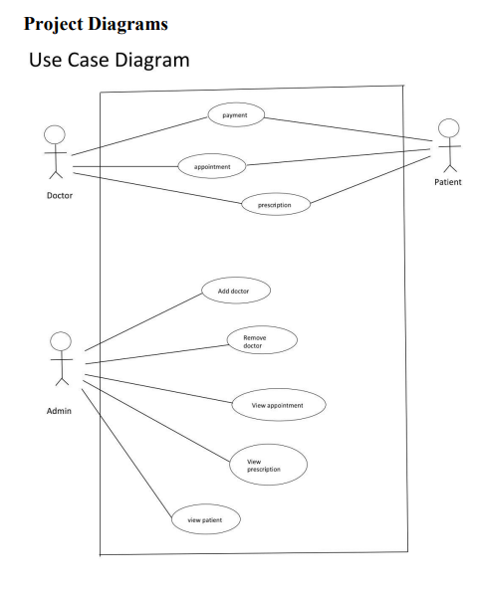
DIAGRAM
Use Case Diagram:

Slide 6
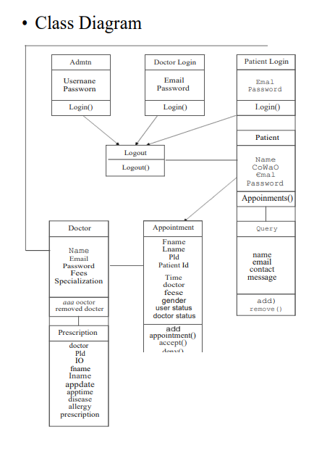
Class Diagram:

Slide 7
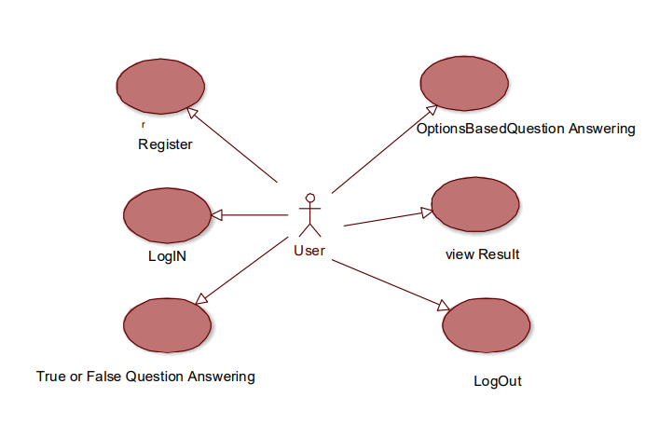
Activity Diagram:

Slide 8
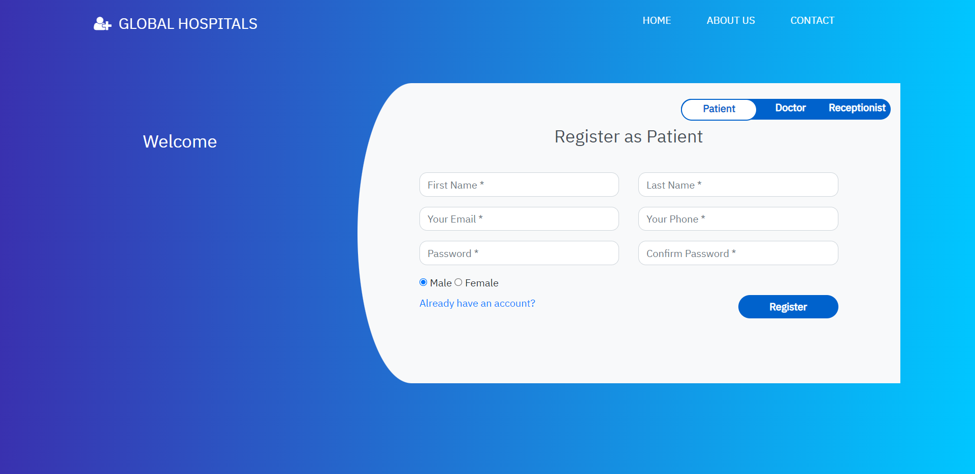
Register as Patient
Register as Patient
Register as Patient

Slide 9
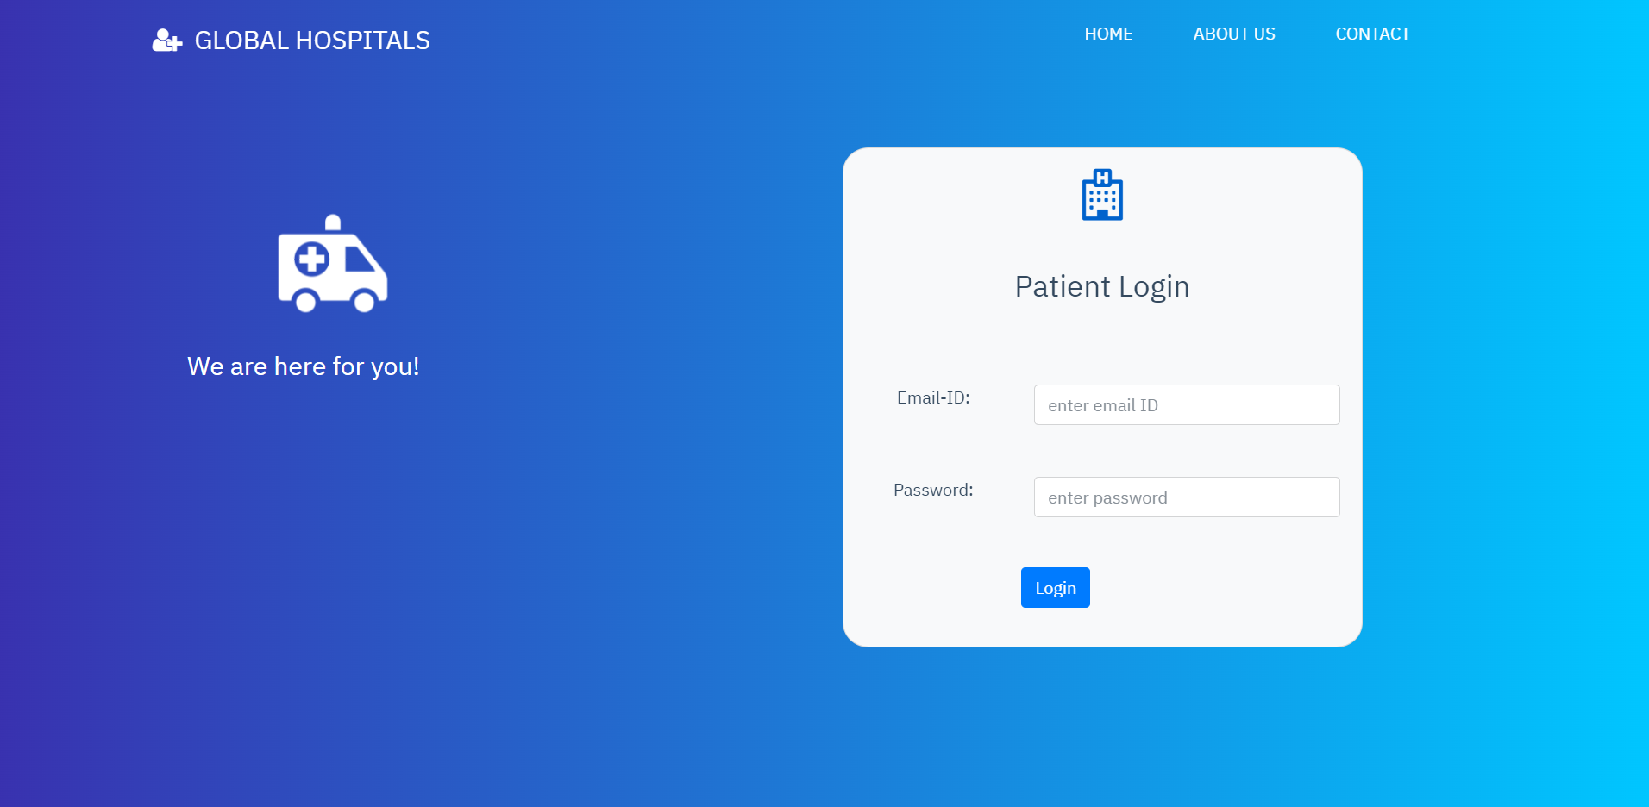
Patient Login

Slide 10
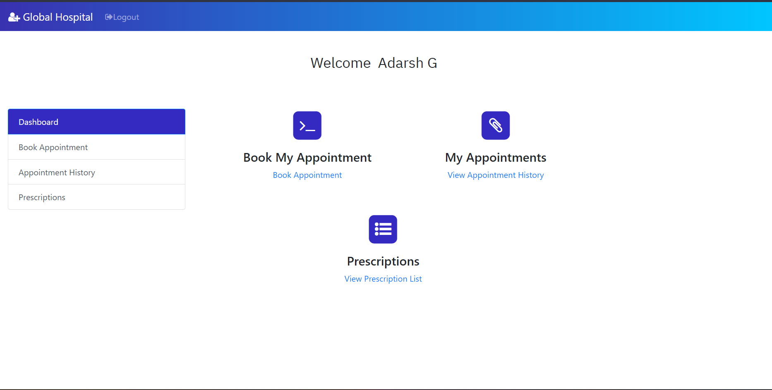
Patient Dashboard

Slide 11
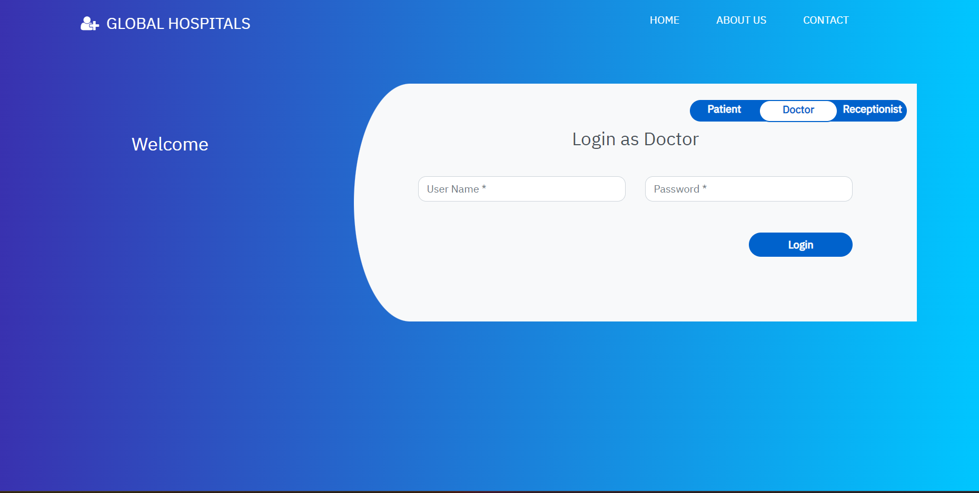
Doctor Login

Slide 12
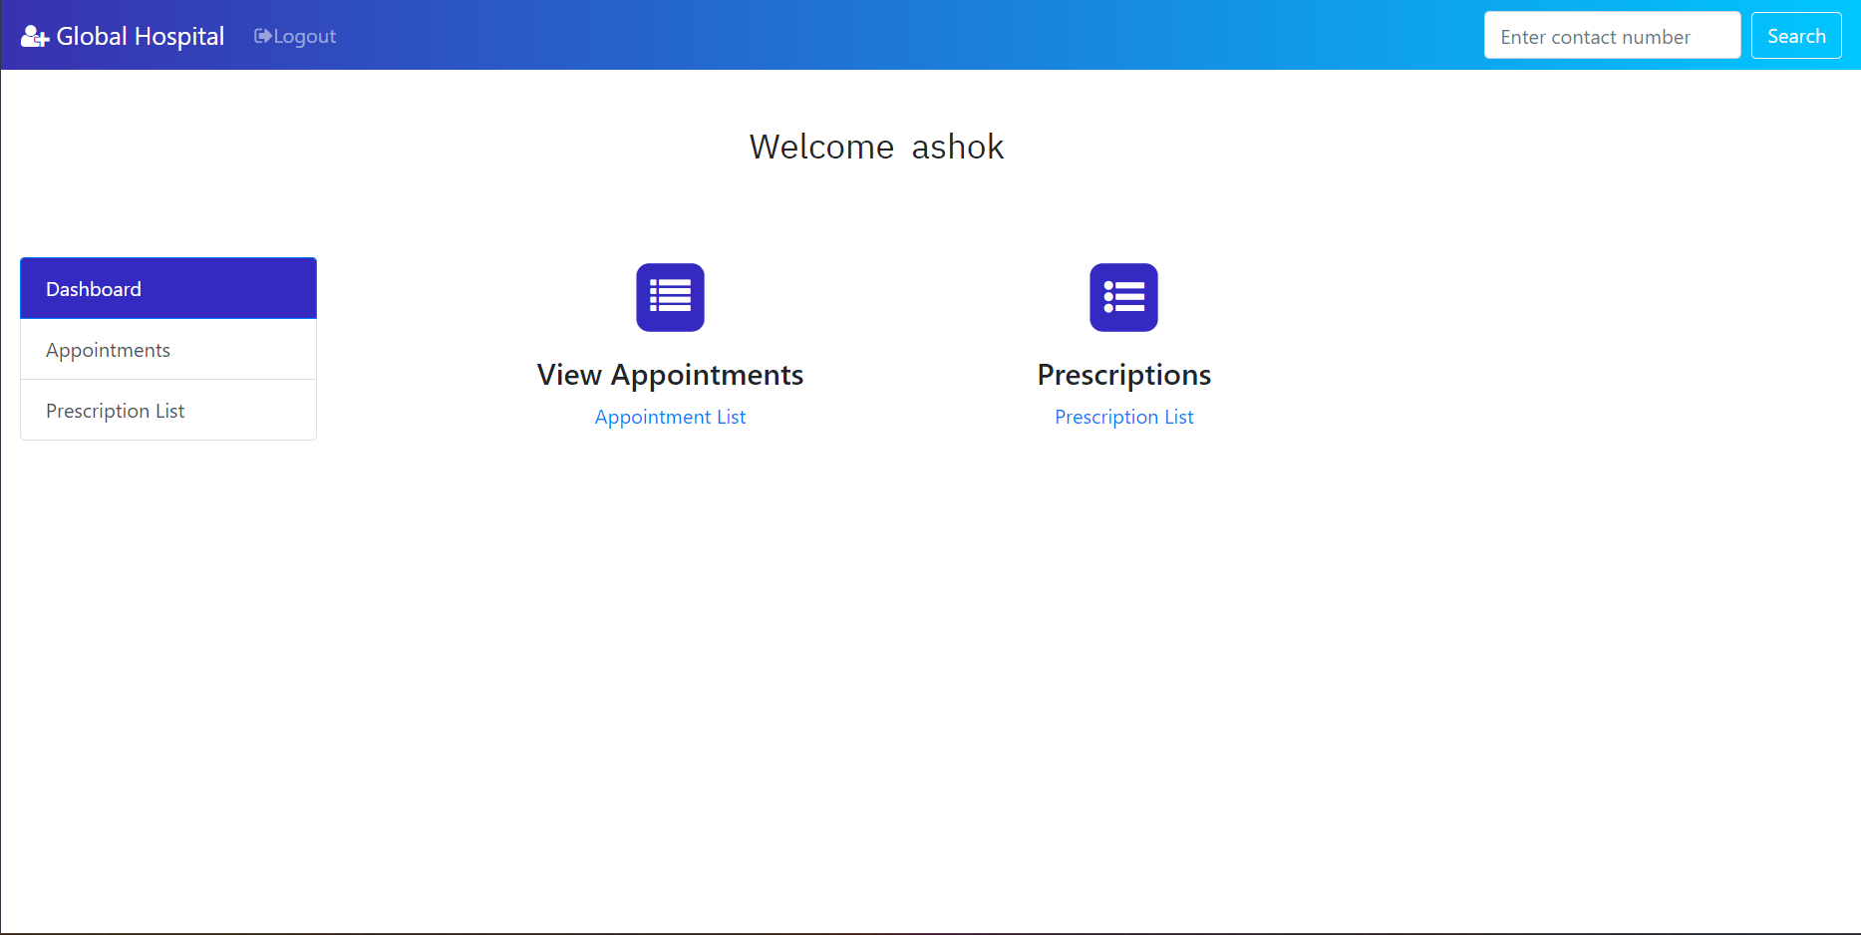
Doctor Dashboard

Slide 13
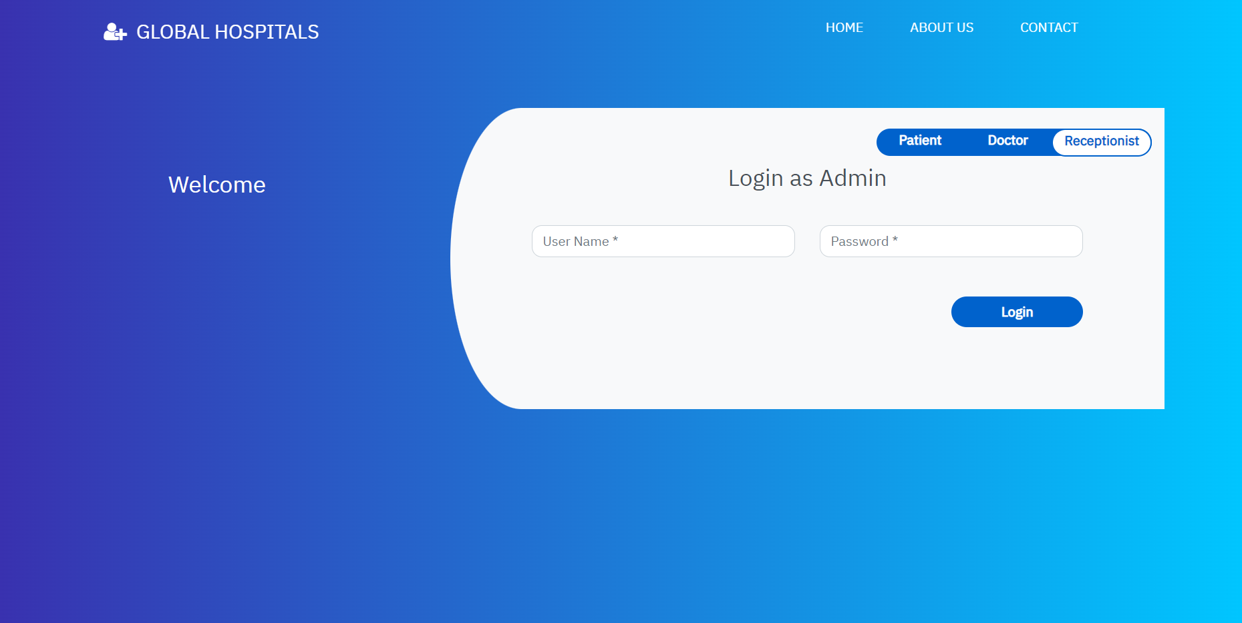
Admin Login

Slide 14
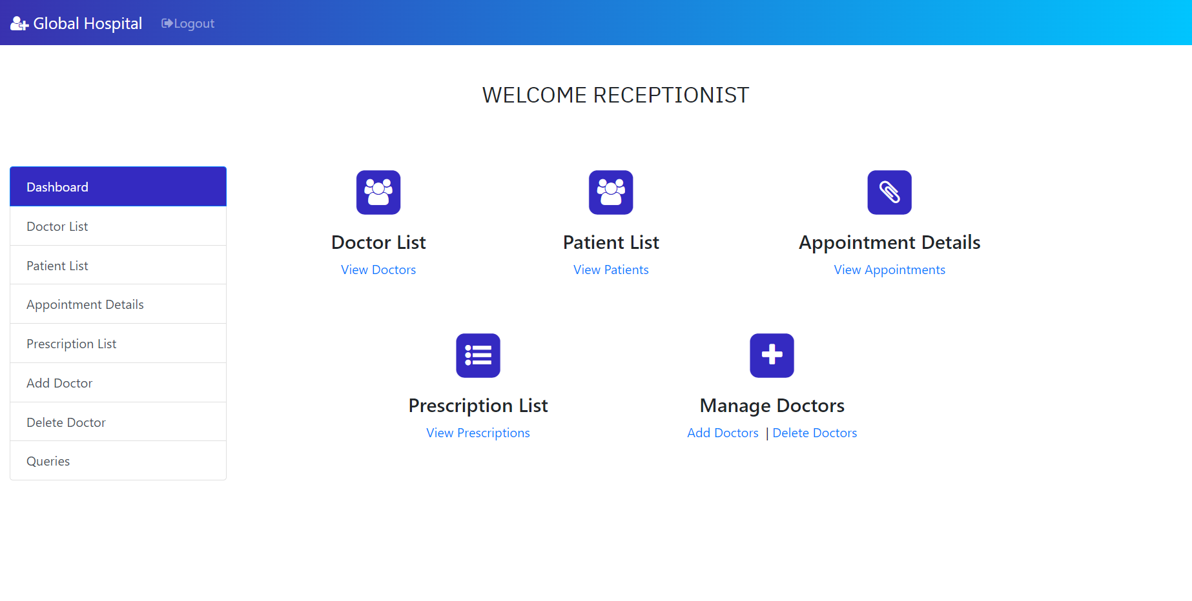
Admin Dashboard

Slide 15
THANK YOU

